Slide 1


Introduction to RDM and Data Management Planning
Joy Davidson
Digital Curation Centre
http://www.dcc.ac.uk/dmps-for-researchers-salford

Slide 2
About this course
Short presentations with exercises and discussion
Introduction to RDM and Data Management Planning
DMPonline demonstration
Exercise to review a DMP
DMP support and guidance at Salford

Slide 3
… a quick quiz
1. How long do RCUK funders typically expect research data of long-term value to be preserved?
a) 10+ years
b) In perpetuity
c) 5 years
Notes:
Qustion 1
Correct! Most funders expect data to be preserved for 10 years, or longer if it has particular significance.
b) Wrong answer. Only The STFC asks organisations to retain data which can not be re-measured 'in perpetuity'. And the EPSRC requirement can in effect mean keeping data forever, if there are regular access requests.
c) Wrong answer. Only Cancer Research UK notes a minimum period of 5 years. Typically funders expect data to be preserved for 10 years or more.

Slide 4
2. Which RCUK funders expect researchers to submit data management and sharing plans as part of their grant application?
a) All of them
b) None of them
c) Some of them
Notes:
Wrong answer.
b) Wrong answer.
c) Correct answer. The majority of RCUK funders now expect a data management plan at the grant application stage. The BBSRC has asked researchers to submit data sharing plans since 2007.The STFC introduced a requirement for data management plans in 2011. EPSRC does not ask for DMPs to be submitted in grant applications but expects that one will exist locally.

Slide 5
3. When are researchers in receipt of RCUK grants expected to make their data available?
a) as soon as possible, typically on publication of results
b) within 3 years of the end of the award
c) it’s up to the researcher to decide
d) never
Notes:
a) Correct - Research funders typically expect data to be available as soon as possible.
b) Correct - Embargo periods are allowed and should be based on common practice for the particular discipline. This may mean that data can’t be shared for a number of years, however researchers should endeavour to share as soon as possible.
c) Correct – researchers need to determine whether their data can be shared as this may not be possible due to legal or ethical reasons. However, where data can be shared, they should be made available as soon as possible.
d) Correct - Most funders have expectations for some data to be shared unless there are very clearly defined reasons that this is not possible. These should be made explicit at the grant application stage to avoid problems toward the end of the project.

Slide 6
4. Will RCUK funders consider withholding the final grant payment if data are not offered for deposit at designated data centres?
a) Yes
b) No
Notes:
a) Correct answer. In cases where funders’ sponsor a data centre, researchers are required to offer selected research outputs for deposit as part of the condition of funding. Final grant payment can be with-held if this does not happen. But note, funders’ do not require all data produced in the project – just selected outputs.
b) Wrong answer.

Slide 7
5. Will RCUK funders provide additional funds to cover the costs associated with data management and sharing?
a) Yes
b) No
Notes:
a) Correct answer. RCUK funders have signed up to the RCUK Common Principles on Data Policy, which say it is is appropriate to use public funds to support the management and sharing of publicly-funded research data. However, the costs need to be very explicitly described and justified in the bid. The ESRC will review any costs associated with implementing the data plan as an integral part of the funding decision, and based on this decision, provide appropriate funding for data management. At the moment, the only UK funder who explicitly will not fund RDM and data sharing are CRUK as they consider timely and appropriate data management and sharing an integral component of the research process, so will not provide additional funds for these activities.
b) Wrong answer.

Slide 8
Data Management Planning
Research Data Management Landscape
Data Management Planning

Slide 9

“Data sets are becoming the new instruments of science”
Dan Atkins, University of Michigan

Slide 10

Funders’ expectations of public access
“Publicly funded research data are a public good, produced in the public interest, which should be made openly available with as few restrictions as possible in a timely and responsible manner that does not harm intellectual property.”
RCUK Common Principles on Data Policy
http://www.rcuk.ac.uk/research/Pages/DataPolicy.aspx

Slide 11
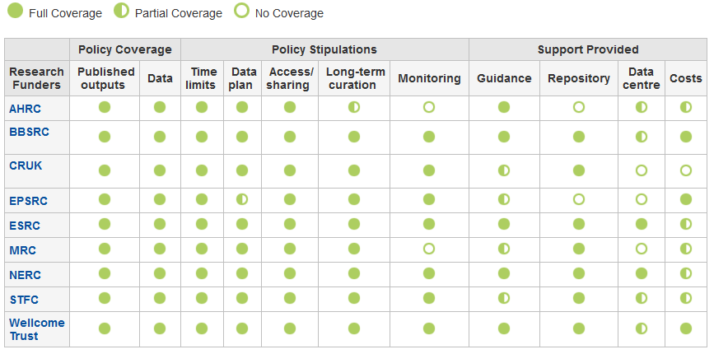
Research funder data policies
www.dcc.ac.uk/resources/policy-and-legal/ overview-funders-data-policies

Slide 12

Ultimately funders expect:
timely release of data
  once patents are filed or on (acceptance for) publication
open data sharing
  minimal or no restrictions if possible
preservation of data
  typically 5-10+ years if of long-term value
See the RCUK Common Principles on Data Policy:
www.rcuk.ac.uk/research/Pages/DataPolicy.aspx

Slide 13

“Research organisations will ensure that effective data curation is provided throughout the full data lifecycle, with ‘data curation’ and ‘data lifecycle’ being as defined by the Digital Curation Centre. The full range of responsibilities associated with data curation over the data lifecycle will be clearly allocated...”
...institutional responsibility
www.epsrc.ac.uk/about/standards/researchdata/Pages/expectations.aspx

Slide 14
Data Management Planning
Planning to Share
Data Management Planning

Slide 15

Benefits related to sharing data
Avoids duplication
Scientific integrity
More collaboration
Increased citation
(Piwowar H. and Vision T.J 2013 , https://peerj.com/preprints/1.pdf)
Notes:
We looked a bit at the drivers for data sharing earlier but it is important to stress the potential benefits to be realised as well.
Duplication – some funders want evidence in applications that researchers are not re-collecting data that already exists. At a minimum, it is a good idea to at check and funder sponsored data centre to see if the research proposed has already been carried out. If so, the researcher will need to justify why the data needs to be collected again (quality, scope etc).
Integrity – RDM is just part of good research practice. Worrying statistics recently about the low number of published research that is reproducable. Most HEIs keen to improve research integrity.
Collaborative opportunities – by making research outputs more visible and understandable to those outside their discipline, researchers may find that they are invited into more interdisciplinary proposals. HEIs and funders very keen on interdisciplinarity.
More citations – recent studies have revealed anywhere between a 9-30% increase in citations for those who make their data available along with their publications. As seen in the recent REF, this is always a good thing for researchers’ status and that of the HEIs who employ them

Slide 16
Who is involved in data sharing?
  the data sharer (researcher)
  the data repository
  support staff
  research participants
  the secondary data user
  commercial partners
Notes:
First, what do we mean by data sharing? We are making data available to researchers for scholarly work.
While the researchers themselves will have a key role to play in sharing data, it is important to note that they are not the only stakeholders involved in the process.
Repository – how will data be made visible?
Support staff – e.g., Library staff to help describe data to make it easier to find and understand.
Research participants – informed consent is required (come back to this later)
Secondary user – when sharing data, researchers can ask reusers to tick that they accept terms and conditions regarding fair use
Commercial – identify what can and can’t be shared and make this explicit.

Slide 17
Considerations
  Ethics
  Informed consent – cover current and future use
  Confidentiality – is anonymisation appropriate?
  Access control – who, what, when?
  IPR
  Clarify copyright before research starts
  Consider licensing options e.g. Creative Commons
Notes:
When dealing with sensitive data, there will need to be a balance between data protection with data sharing.
Best to make early contact with ethics team for advice and guidance. Often, institutional workflows mean that researchers only speak to ethics advisors when a grant has been awarded. This could be a risk as there may be a failure to reflect the aims for data sharing as outlined in the proposal once the award ahs been made.
In terms of costing, a delay in understanding what can and can’t be shared may mean that the grant application does not reflect the costs associated with data sharing. E.g., a small award of £10K where research participants will be interviewed and the interviews will be video-taped. Unless there is informed consent, it may mean that the video data cannot be shared without expensive anonymisation. In many cases, this can cost more than the original grant is worth. Best to decide early what participants will sign up to and to look for more cost effective alternatives (e.g., video data won’t be shared but anonymised transcripts will be).
Who will have access and when – timing is important. Decide who will have access and how during the life of the project. Will any security measures need to be in place for sharing between partners?
For projects involving commercial partners, much of the information requested in the data management plan may be covered in industrial agreements that are drawn up either at the pre-award or in-award phases. There may be potential to reuse the information provided in the data management plan for the industrial agreement and vice versa.

Slide 18




Use appropriate repositories - institutional
http://datashare.is.ed.ac.uk
Research Data at Essex and
DataPool at Southampton
www.dspace.cam.ac.uk
  https://databank.ora.ox.ac.uk
Notes:
Not just looking for an indication that data will be shared in grant applications, funders want details on how it will be shared and made visible.
Several HEIs are developing new data repositories and/or extending their publications repository to cover research data. Please note though that these are not intended to replace national, subject or other established data repositories. Many HEIs choosing to accept data ONLY IF there is no other suitable place of deposit. I.e., a place of last resort.
18

Slide 19








Use appropriate repositories - external
  Research funders’ data centres
  Structured databases
Community initiatives
https://zenodo.org
http://figshare.com
http://www.re3data.org
Notes:
Many funders support data centres and will expect that the data is deposited at the end of the project. In these cases, the researchers just need to be sure to register this with the university so that a link between the published output(s) and the underlying data are recorded to comply with the RCUK OA policy.
If there is no funder-specific data centre, there may be other places of deposit available.
Zenodo – If you have no access to an OpenAIRE compliant repository, an institutional repository or a subject repository, Zenodo, hosted by CERN, will enable you to deposit your article and/or research data. Zenodo exposes its data to OpenAIRE, helping researchers to comply with the Open Access demands from the EC and the ERCs.
Figshare - figshare is a repository where users can make all of their research outputs available in a citable, shareable anddiscoverable manner.

Slide 20
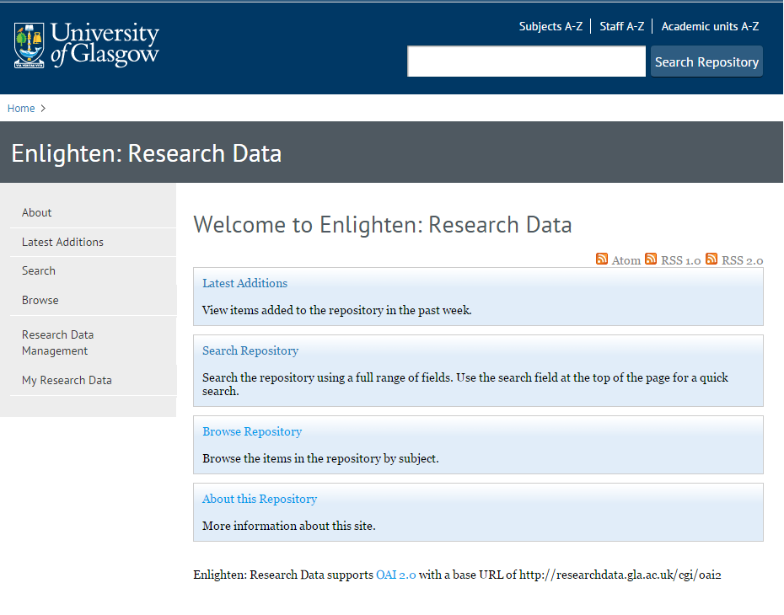
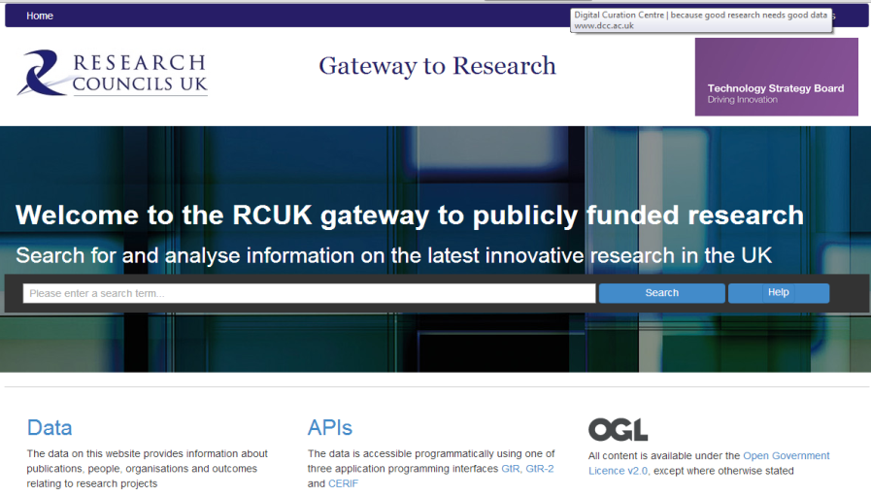
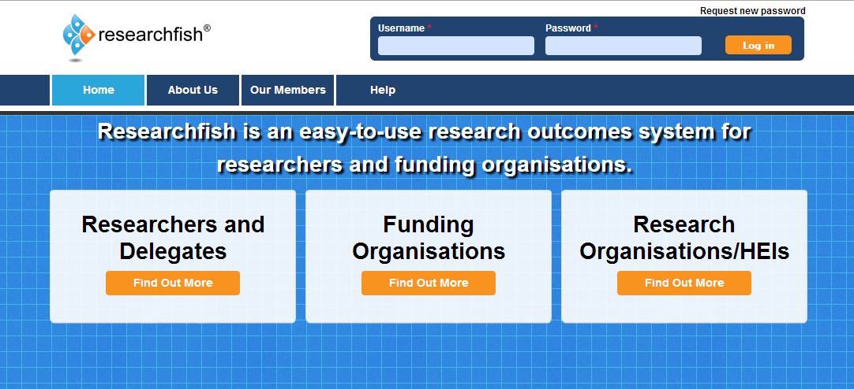
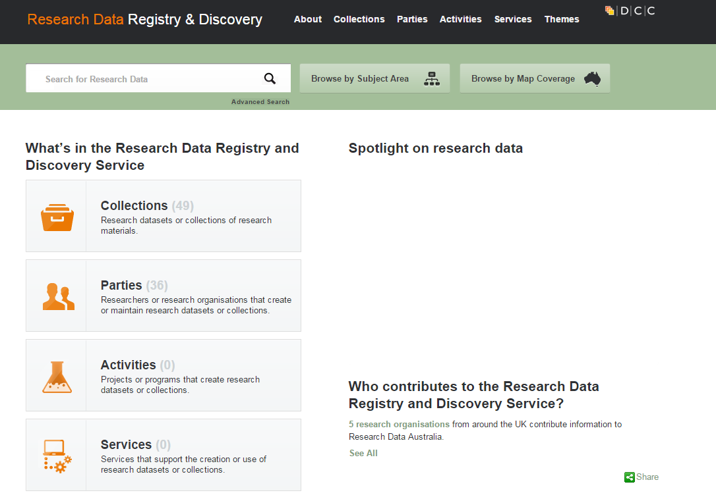
Data Catalogues
Funders
Institutional
National

Slide 21
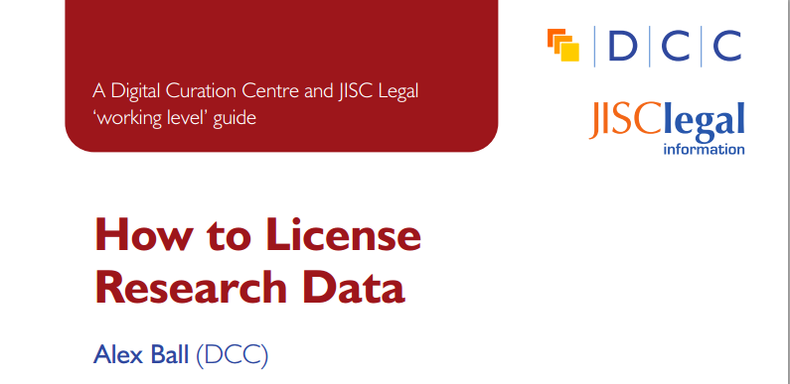
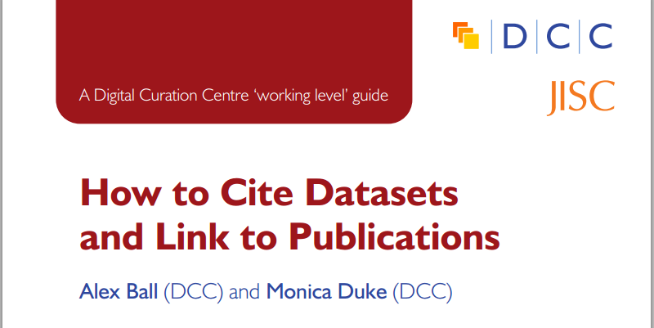
Tips for improving data reuse
www.dcc.ac.uk/resources/how-guides/license-research-data
  http://www.dcc.ac.uk/resources/how-guides/cite-datasets
Notes:
License the data so it is clear how it can be reused
Make sure it’s clear how to cite the data

Slide 22
Data Management Planning
Writing a Data Management Plan
Data Management Planning

Slide 23
What is a data management plan (DMP)?
  What data will be created (format, types, volume...)
  Standards and methodologies to be used (incl. metadata)
  How ethics and Intellectual Property will be addressed
  Plans for data sharing and access
  Strategy for long-term preservation
Create
Preserve
Document
Share
Use
Store
Notes:
What is a Data Management Plan?
1-2 page summary.
Essentially, most funders just want evidence at the grant stage that data has been considered – how much will be generated? What formats will be used? Where will it be stored? Can it be shared?
It is important to stress to researchers at the pre-award stage that funders aren’t expecting something carved in stone . Projects often change quite radically from what is submitted at the proposal stage and this is ok. Researchers just need to be able to provide evidence that they have thought about the data they might be generating and how it will be managed and shared.
In terms of preservation, it is important to remember that not ALL data has to be retained. Selecting what data needs to be kept is something that only the researcher can do. Essentially, he/she will need to retain any data that underpins published findings to allow for validation of results. Additional data that is not required for validation purposes but is deemed to have longer-term value might also be worth keeping.
DMPs are often submitted as part of grant applications, but are useful whenever you’re creating data. Some HEIs are introducing policies that require DMPs for all research undertaken by staff – whether externally funded or not.

Slide 24
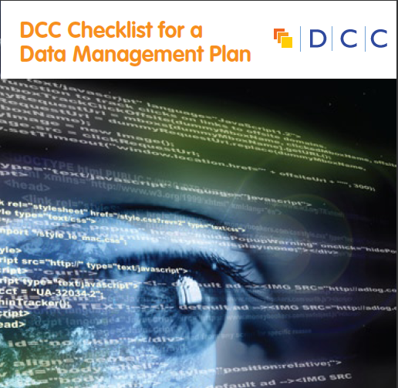
They typically want a short (c.1-2pp) statement covering:
  What data will be created (format, types, volume...)
  Standards and methodologies to be used (incl. metadata)
  How ethics and Intellectual Property will be addressed
  Plans for data sharing and access
  Strategy for long-term preservation

Slide 25
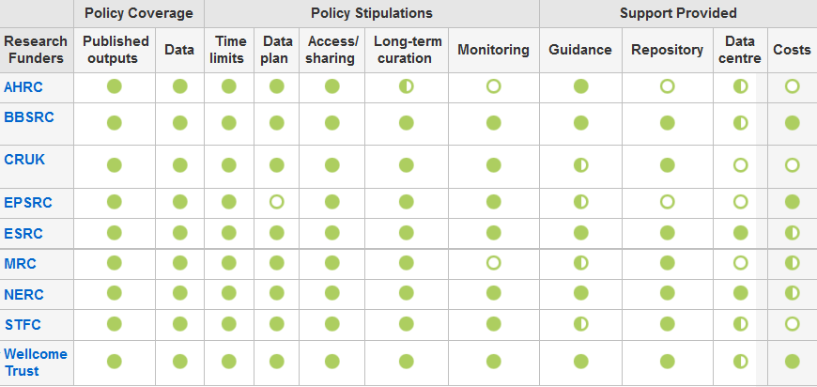
Research funders have DMP requirements
www.dcc.ac.uk/resources/policy-and-legal/overview-funders-data-policies

Slide 26


Data sharing plan
Covering:
Dataset
Standards
Metadata
Preservation
Data sharing
  method
  timescale
  restrictions
  agreements
Data Mgmt Plan
Covering:
Data
Data sharing
  when?
  where?
  how?
  restrictions?
Preservation
Resources
Data Mgmt Plan
Covering:
Data
Data collection
Management
Security
Data sharing
Responsibilities
Related policies
Admin details
Notes:
What do funders want to see? Some variations in what they want to see covered and in how much detail.

Slide 27
Why bother?
compliance
to help you manage your data
to provide guidelines for everyone to work to
to anticipate and avoid problems e.g. data loss, breaches
to avoid duplication
Notes:
Most will write a DMP to comply with funders requirements...but there are other benefits

Slide 28

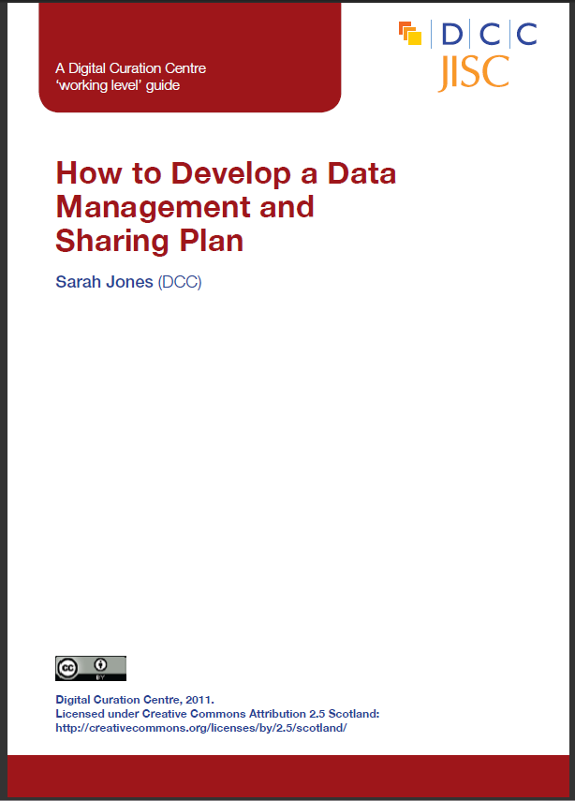
The DCC offers DMP guidance and tools
www.dcc.ac.uk/resources/data-management-plans
Notes:
The DCC’s DMP Online tool helps researchers write Data Management and Sharing Plans that meet specific funder’s requirements.
Short guides to help you consider responses.

Slide 29
Tips for writing DMPs
  Start early - don’t wait until the last minute to develop plan!
  Don’t try to write the plan in isolation – seek advice from colleagues, ethics, IT, library, DP/FoI...
  Be realistic - base plans on available skills & support
  The plan will - and should - change over life of project

Slide 30
Local workflow considerations
  Will support staff or researchers initiate the plan? What might be the best option?
  Will you deposit a copy of the grant stage DMP as part of funding application records?
  Will you submit a final version of the DMP in your institutional repository?

Slide 31
Data Management Planning
Research Data Management Costs
Data Management Planning

Slide 32
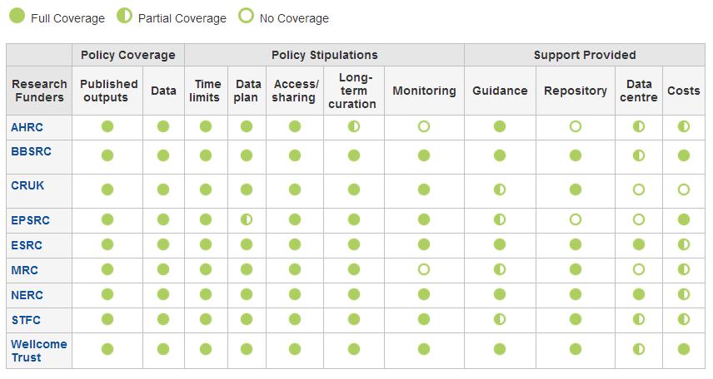
Research funders’ policies
www.dcc.ac.uk/resources/policy-and-legal/overview-funders-data-policies

Slide 33
How should RDM costs be included?
In-project costs only
Up front payments could be included as in-project costs (e.g. Arkivum)
Justify your budget request – be specific about additional costs relating to:
  collecting data
  curating data
  analysing data
  preservation and sharing
  UK Data Service costing checklist can help
  http://www.data-archive.ac.uk/media/247429/costingtool.pdf
Notes:
Need to distinguish between the costs that are incurred during a project and those that arise afterwards.
In-project (direct) costs:
covers hardware, staff, expenses, costs of preparing data & metadata...
Post project (largely indirect) costs:
existing services should be used where possible
where an institution is going to provide a data repository, costs should be met through FEC
outsourcing to a third-party is also an option

Slide 34
Key messages
Justified RDM costs will not detract from the competitiveness of your proposal.
Data management planning can help to make clear what activities need to be charged against a grant (e.g., data cleaning).
The cost of RDM is project-specific and entirely depends on the type of work.

Slide 35
Thanks –any questions?

